Slide 1
EFRAIN
For a better world ☺

Slide 2
Group members
Santiago Coelho
Massine Akilal
Morgane Barillet-Genestier
Djohan Salim

Slide 3




Why did we choose this name ?
Group composed of 4 students from 3 different countries
Ecuador
France
Indonesia
EFRAIN

Slide 4
What context ?
Our world
Technologies
Social Networks
Sharing knowledge/thinks

Slide 5

What do we want do to ?
My-Che (车: car)
Making travel social and efficient
Focus: sharing long and short distance transportation, eventual and continuous
Analyze applications or similar services that already exist and potential to implement this in different parts of the world and it impacts.

Slide 6

Small scenari !
A person who everyday move from Wudaokou to Sanlitun for work, could find maybe a neighbor or a person who live near that usually move in the same direction, and share expenses.
A person that is going to travel this weekend to Tianjin and is going alone, want travel accompanied and also share expenses.
A person who wants to came back from sanlitun to wudaokou at 2 am, and is many people waiting for taxi and so few taxis available

Slide 7


Blabla car , the French success

Slide 8
How to make money ?
Given some information to companies about the different kind of products that people have and could need.
Some few advertisement related to what people is looking for.
Recommending some place (restaurants, hotels, promotions, etc) that could visit when people is moving to another place.
Also taking money from user who rent their stuffs.

Slide 9
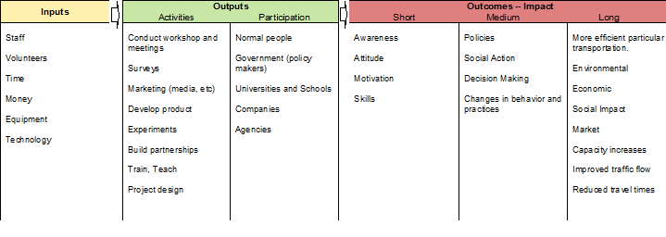
Logic Model

Slide 10
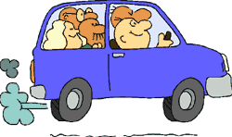
Thanks for your attention

